Slide 1
White-box testing techniques contd…
Dr. Durga Prasad Mohapatra
Professor, Dept. of CSE
N.I.T Rourkela
1

Slide 2
Path Coverage
Design test cases such that:
  All linearly independent paths in the program are executed at least once.
Defined in terms of
  Control flow graph (CFG) of a program.

Slide 3
Path Coverage-Based Testing
To understand the path coverage-based testing:
  we need to learn how to draw control flow graph of a program.
A control flow graph (CFG) describes:
  The sequence in which different instructions of a program get executed.
  The way control flows through the program.

Slide 4
How to Draw Control Flow Graph?
Number all statements of a program.
Numbered statements:
  Represent nodes of control flow graph.
An edge from one node to another node exists:
  If execution of the statement representing the first node
    Can result in transfer of control to the other node.

Slide 5
Example
int f1(int x,int y){
1 while (x != y){
2 if (x>y) then
3 x=x-y;
4 else y=y-x;
5 }
6 return x; }

Slide 6
Example Control Flow Graph
1
2
3
4
5
6

Slide 7
How to Draw Control flow Graph?
Sequence:
  1 a=5;
  2 b=a*b-1;
1
2

Slide 8
How to Draw Control Flow Graph?
Selection:
  1 if(a>b) then
  2 c=3;
  3 else c=5;
  4 c=c*c;
1
2
3
4

Slide 9
How to Draw Control Flow Graph?
1
Iteration:
  1 while(a>b){
  2 b=b*a;
  3 b=b-1;}
  4 c=b+d;
2
3
4

Slide 10
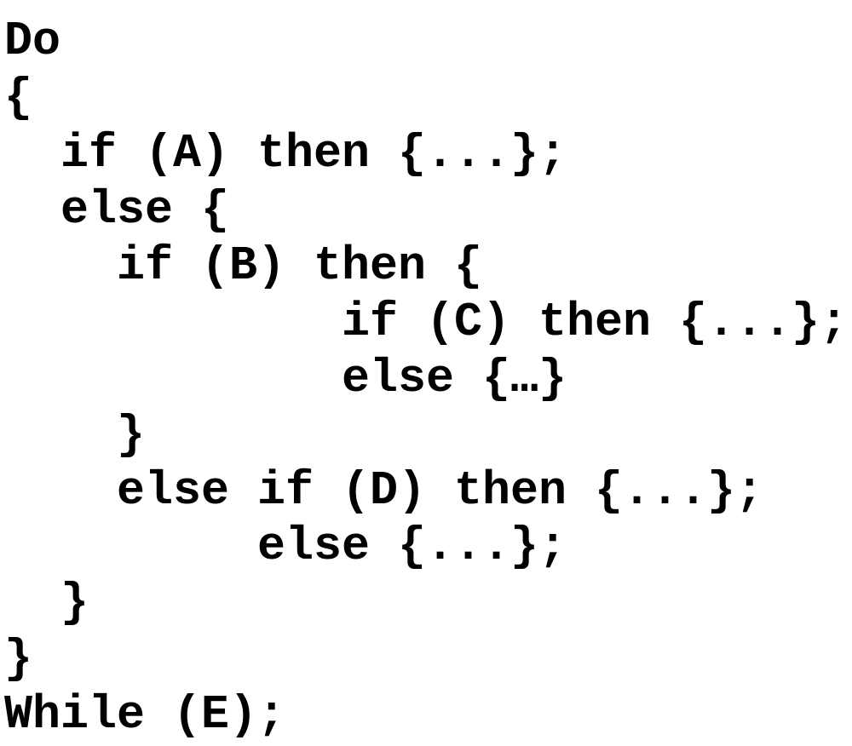
Example Code Fragment

Slide 11
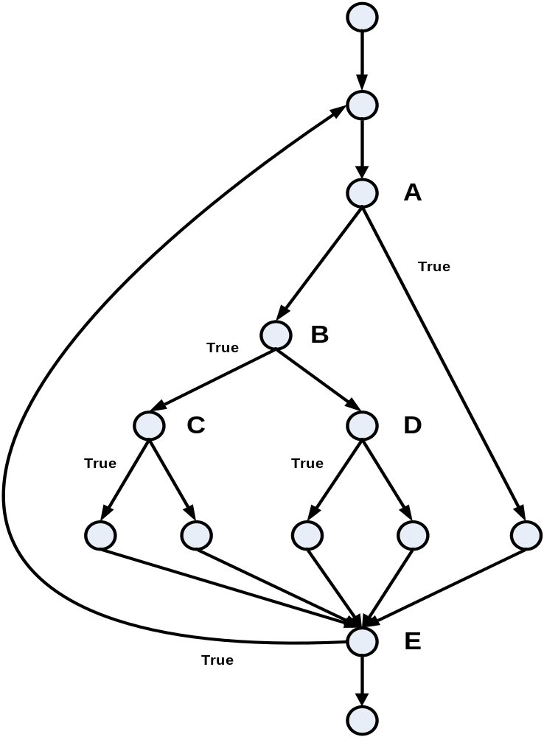
Example Control Flow Graph
Source: The Art of Software Testing – Glenford Myers

Slide 12
Path
A path through a program:
  A node and edge sequence from the starting node to a terminal node of the control flow graph.
  There may be several terminal nodes for program.

Slide 13
Linearly Independent Path
Any path through the program:
  Introduces at least one new edge:
    Not included in any other independent paths.

Slide 14
Independent path
It is straight forward:
  To identify linearly independent paths of simple programs.
For complicated programs:
  It is not easy to determine the number of independent paths.

Slide 15
McCabe's Cyclomatic Metric
An upper bound:
  For the number of linearly independent paths of a program
Provides a practical way of determining:
  The maximum number of linearly independent paths in a program.

Slide 16
McCabe's Cyclomatic Metric
Given a control flow graph G,
cyclomatic complexity V(G):
  V(G)= E-N+2
    N is the number of nodes in G
    E is the number of edges in G

Slide 17
Example Control Flow Graph
1
Cyclomatic complexity =
7-6+2 = 3.
2
3
4
5
6

Slide 18
Cyclomatic Complexity
Another way of computing cyclomatic complexity:
  inspect control flow graph
  determine number of bounded areas in the graph
V(G) = Total number of bounded areas + 1
  Any region enclosed by a nodes and edge sequence.

Slide 19
Example Control Flow Graph
1
2
3
4
5
6

Slide 20
Example
From a visual examination of the CFG:
  Number of bounded areas is 2.
  Cyclomatic complexity = 2+1=3.

Slide 21
Cyclomatic Complexity
McCabe's metric provides:
    A quantitative measure of testing difficulty and the ultimate reliability
Intuitively,
  Number of bounded areas increases with the number of decision nodes and loops.

Slide 22
Cyclomatic Complexity
The first method of computing V(G) is amenable to automation:
  You can write a program which determines the number of nodes and edges of a graph
  Applies the formula to find V(G).

Slide 23
Cyclomatic Complexity
The cyclomatic complexity of a program provides:
  A lower bound on the number of test cases to be designed
  To guarantee coverage of all linearly independent paths.

Slide 24
Cyclomatic Complexity
A measure of the number of independent paths in a program.
Provides a lower bound:
  for the number of test cases for path coverage.

Slide 25
Cyclomatic Complexity
Knowing the number of test cases required:
  Does not make it any easier to derive the test cases,
  Only gives an indication of the minimum number of test cases required.

Slide 26
Practical Path Testing
The tester proposes initial set of test data :
  Using his experience and judgment.
A dynamic program analyzer used:
  Measures which parts of the program have been tested
  Result used to determine when to stop testing.

Slide 27
Derivation of Test Cases
Draw control flow graph.
Determine V(G).
Determine the set of linearly independent paths.
Prepare test cases:
  to force execution along each path.

Slide 28
Example
int f1(int x,int y){
1 while (x != y){
2 if (x>y) then
3 x=x-y;
4 else y=y-x;
5 }
6 return x; }

Slide 29
Example Control Flow Diagram
1
2
3
4
5
6

Slide 30
Derivation of Test Cases
Number of independent paths: 3
  1,6 test case (x=1, y=1)
  1,2,3,5,1,6 test case(x=2, y=1)
  1,2,4,5,1,6 test case(x=1, y=2)

Slide 31
An Interesting Application of Cyclomatic Complexity
Relationship exists between:
  McCabe's metric
  The number of errors existing in the code,
  The time required to find and correct the errors.

Slide 32
Cyclomatic Complexity
Cyclomatic complexity of a program:
  Also indicates the psychological complexity of a program.
  Difficulty level of understanding the program.

Slide 33
Cyclomatic Complexity
From maintenance perspective,
  Limit cyclomatic complexity of modules
    To some reasonable value.
  Good software development organizations:
    Restrict cyclomatic complexity of functions to a maximum of ten or so.

Slide 34
White-Box Testing : Summary
weakest
statement
coverage
condition
coverage
branch
(or decision)
coverage
branch and condition
(or condition /decision) coverage
independent path (or basis path)
coverage
modified condition / decision coverage
multiple- condition
coverage
only if paths across
composite conditions
are distinguished
strongest
path
coverage

Slide 35
Summary
There are two approaches to testing:
  black-box testing and
  white-box testing.
Designing test cases for black box testing:
  does not require any knowledge of how the functions have been designed and implemented.
  Test cases can be designed by examining only SRS document.

Slide 36
Summary
White box testing:
  Requires knowledge about internals of the software.
  Design and code is required.
We have discussed a few white-box test strategies.
  Statement coverage
  Branch coverage
  Condition coverage
  MC/DC coverage
  Path coverage

Slide 37
Summary
A stronger testing strategy:
  Provides more number of significant test cases than a weaker one.
  Condition coverage is strongest among strategies we discussed.
We discussed McCabe’s Cyclomatic complexity metric:
  Provides an upper bound for linearly independent paths
  Correlates with understanding, testing, and debugging difficulty of a program.

Slide 38
References
Rajib Mall, Fundamentals of Software Engineering, (Chapter – 10), Fifth Edition, PHI Learning Pvt. Ltd., 2018.
Naresh Chauhan, Software Testing: Principles and Practices, (Chapter – 5), Second Edition, Oxford University Press, 2016.

Slide 39
Thank you

